Slide 1

jero98772

Slide 2

Warning /!\

Slide 3
content
What is flask
Install
Hello word
File structure
Phory
Tricks
Add html,css and js,image
Jinja
Code2html, hipl
Templates
Request y cookies

Slide 4
What is flask
Microframework for build websites and services
Support metaprograming
Adaptable(Combinable) to microcontrolers
Machine lerning Adaptable(Combinable ) run server side and help in front

Slide 5
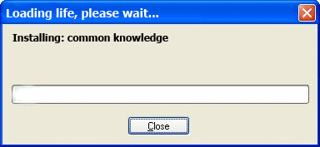
install
pip install Flask

Slide 6
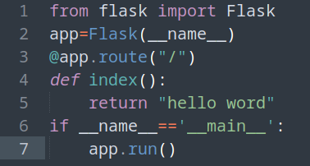
Hello word
Do you like to do Hello word?

Slide 7
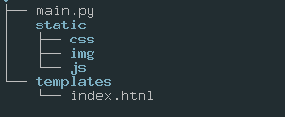
File structure

Slide 8
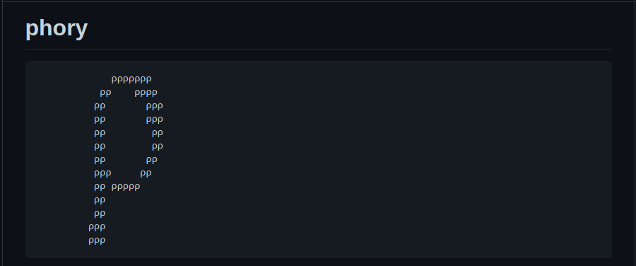
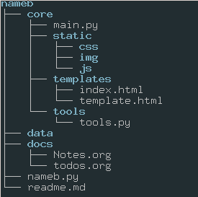
MY file structure made with phory
https://github.com/jero98772/phroy

Slide 9
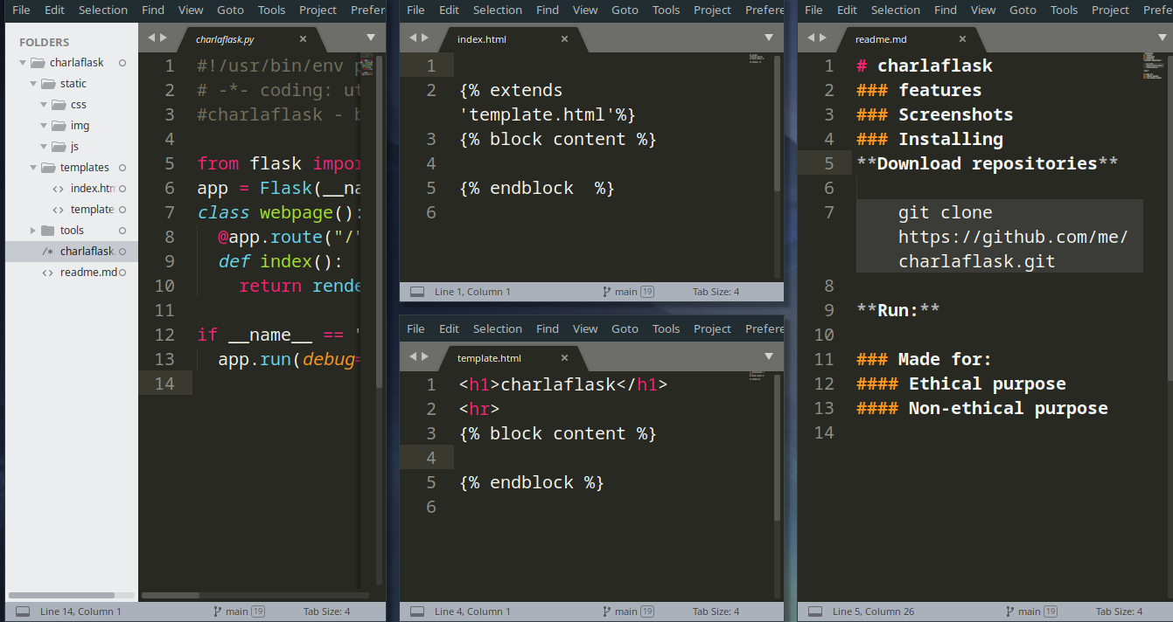
Made with phory
python phroy.py charlaflask -s flask -l python

Slide 10
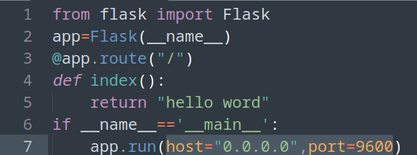
Search a couple "HACKY" 1

Slide 11




add Css?,js?,html?, media? To Flask

Slide 12

Whaaaaaaaaaaat jinga2 is important ?

Slide 13

Linking files with jinja2
Html Python file-> return render_template(<html file>)
In html file {{ url_for('static',filename='') }}
Media ->{{ url_for('static', filename='img/1.png')}}
JS -> {{ url_for('static',filename='js/1.js') }}
CSS -> {{ url_for('static',filename='css/1.css') }}

Slide 14
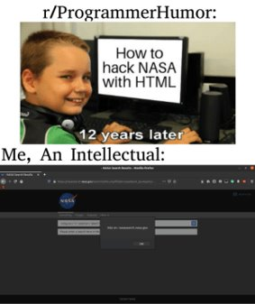
html
https://youtu.be/hEiD2z1AByM?t=1584

Slide 15
with jinja you can programing in html
{{ variables }}
{% control structures %}-> if,for,else...
{# comments #} -> <!-- --> {{ my_var }}
{% if %}{% elif %}{% else %}{% endif %}
{%for %}{% endfor%}

Slide 16
Create other function for web page and ..
Add video, image ,audio or javascript and use jinja to repeat theam n times

Slide 17
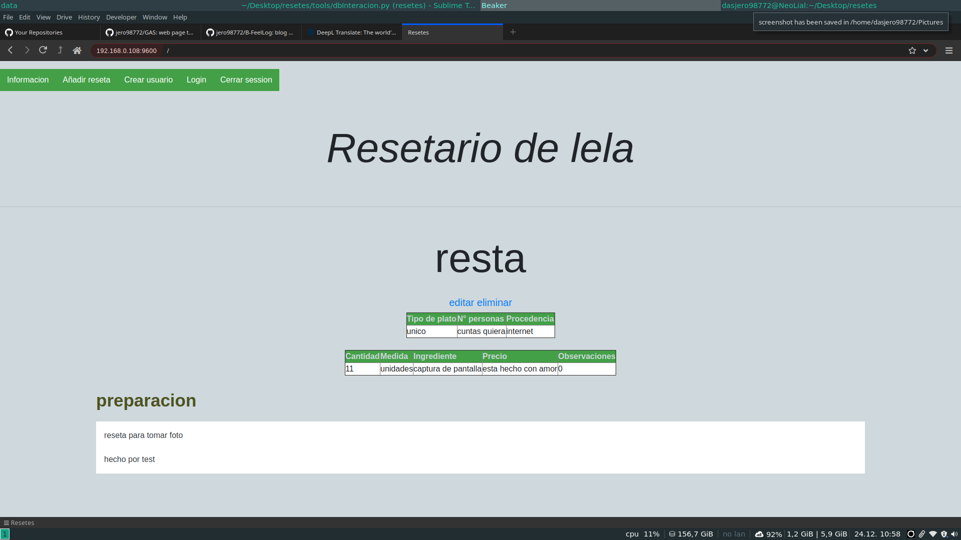
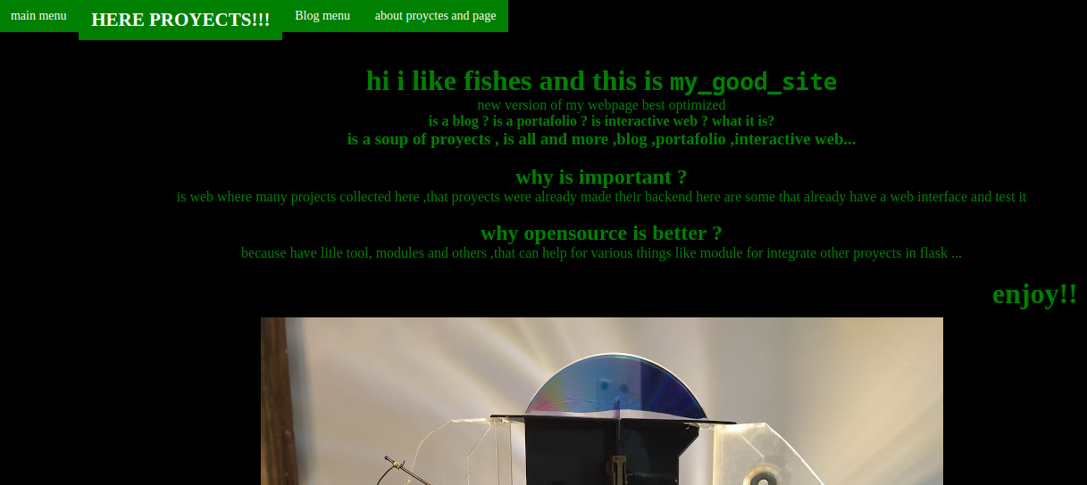
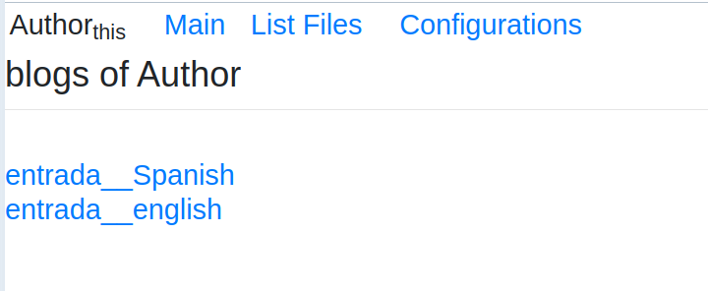
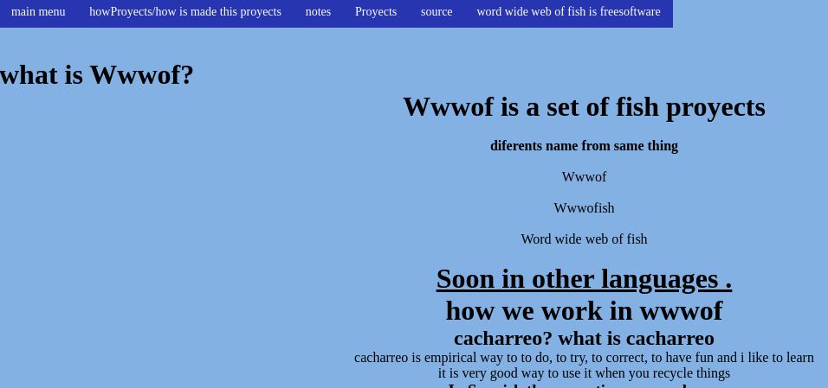
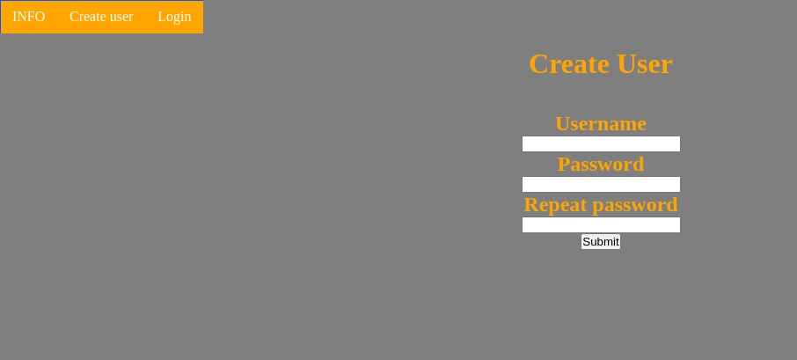
Templates
Write less do more

Slide 18
Create menu bar
File one.html
<h1>one</h1> {% block content %}
{% endblock %}}
file two.html​
{% extends 'template.html'%}​
{% block content %}​
<h1>two</h1>​
{% endblock %}​

Slide 19
request
<form method="post" enctype="multipart/form-data"> </from>
@app.route("/",methods=['POST','GET'])
if request.method == "POST": file = request.files["file"] name=request.form["name"]

Slide 20

Session's or cookies
Dicccionary -> session[key]=value
Why no a normal diccionary?
Why use cookies if can use data base?
{{ session['username'] }}

Slide 21
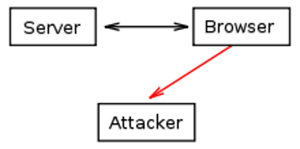
Cookies Warning /!\
session[password]=password key -> http(s)
If i need save the user password as cookie what i can do?

Slide 22

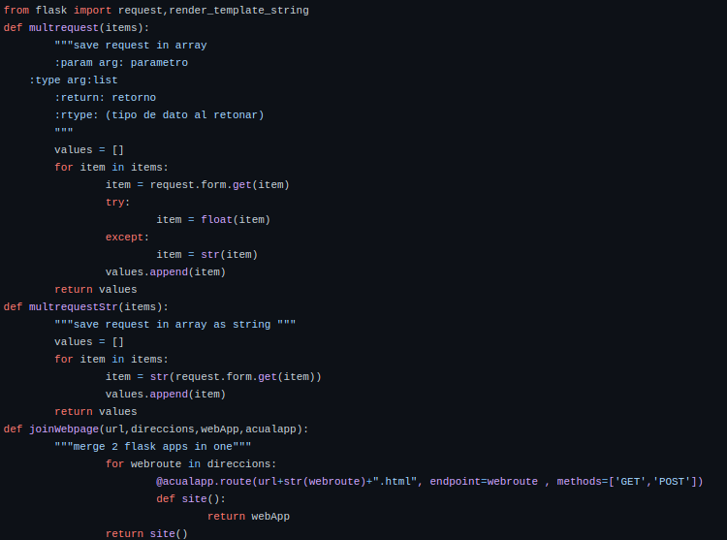
Meta programing in flask
https://github.com/jero98772/jerotools/blob/main/jerotools/flaskTools.py

Slide 23
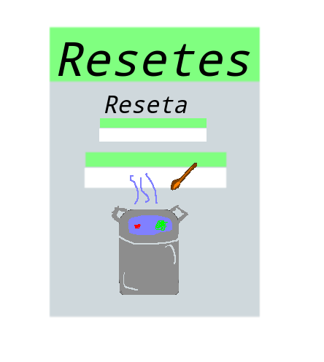


What we can do with we learn today
Online file system
Cms
Blog
Portfolio Website
Social Network
https://jero98772.pythonanywhere.com/

Slide 24

Integrate computer vison models, when?

Slide 25
thanks

